Slide 1

Data Analytics Portfolio
Project case studies
By Brian Avila

Slide 2

Table of Contents
Skillsets
Case Study 1: Influenza Medical Staffing Plan
Case Study 2: Rockbuster Stealth Sales Data Analysis
Case Study 3: Pig E Bank’s Client Exit Analysis
Case Study 4: Instacart Grocery
Basket Analysis
Case Study 5: Main Contributors to Happiness
Case Study 6: Gameco Sales Analysis
Case Study 7: Chocolate Ratings Analysis
Project Links
Contact info

Slide 3

Skillsets
My Skills
Data Analysis
Tableau Visualizations
SQL Relational Databases
PostgreSQL
Python
MS Excel (Pivot Tables, VLOOKUP)
Time Series Analysis and
Forecasting
Statistical Analysis
Data Transformation and integration

Slide 4

Influenza medical staffing plan
Let’s Dive In
GOAL: To help a medical staffing agency that provides temporary workers to clinics and hospitals on an as-needed basis. The analysis will help plan for influenza season, a time when additional staff are in high demand. The final results will examine trends in influenza and how they can be used to proactively plan for staffing needs across the country.

Slide 5


Analysis
Data Sets
Tools
Process
Listed the data questions to be answered.
Designed a Data Research Project
Formulated a research hypothesis
Sourced the Right Data
Created a data profile
Implemented data quality measures
Integrated data from 2 sources into 1.
Conducted Statistical Analysis by calculating variance and standard deviation
Formulated a statistical hypothesis
Created an interim report
Influenza deaths by geography, time,
age, and gender
Source: CDC
Download Data Set
2. Population data by geography
Source: US Census Bureau
Download Data Set
Microsoft Excel

Slide 6
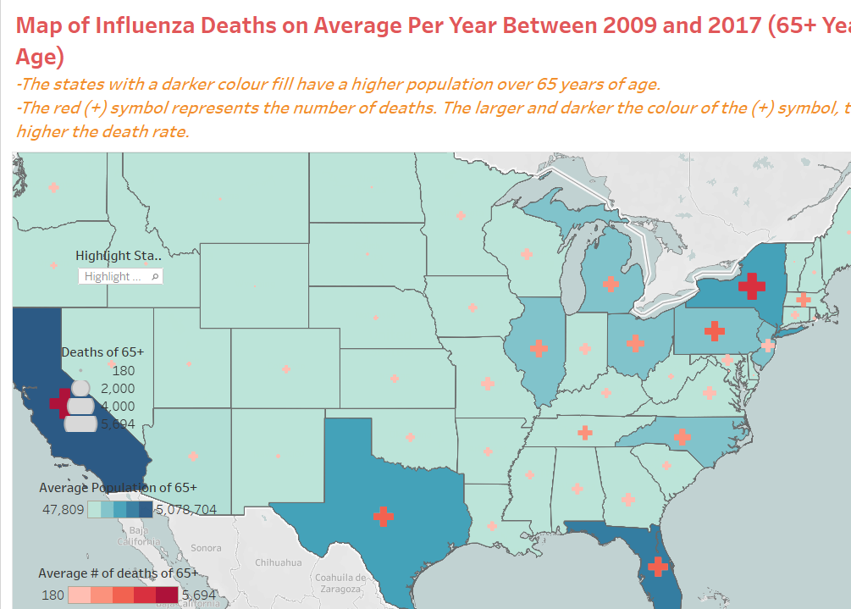
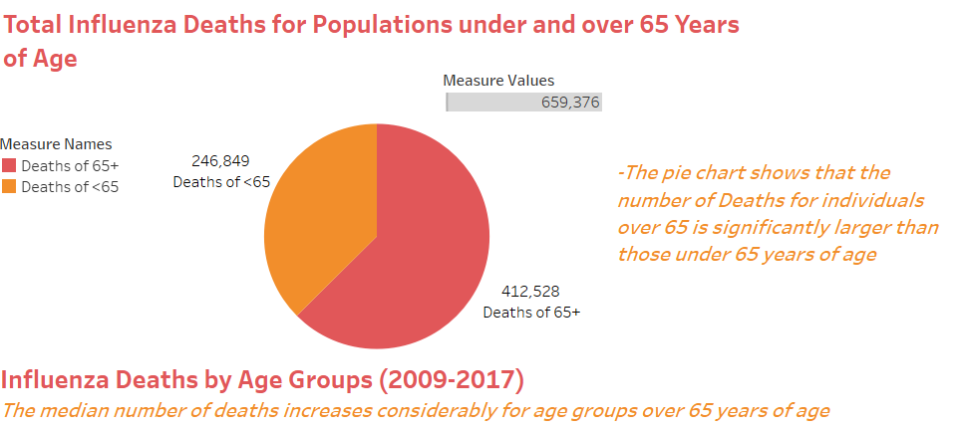
Visualizations & Storytelling

Slide 7
Key Takeaways
Reflecting on the outcomes of the influenza season staffing analysis project:
There were several key insights and recommendations that emerged. The process involved a comprehensive examination of influenza trends, vulnerable demographics, and historical data, leading to actionable strategies for the medical staffing agency. It reinforced the significance of basing decisions on data-driven insights. Leveraging historical data on influenza trends, mortality rates, and demographic distributions allowed for a targeted and informed approach to staffing allocation.
Approach Enhancement for the Next Project:
As I transition to the next project, there are opportunities to enhance my approach and take it to the next level. To elevate the analysis, I’m considering incorporating advanced analytics and machine learning models. These technologies can provide more accurate predictions of influenza trends, allowing for even more precise and timely staffing decisions.

Slide 8
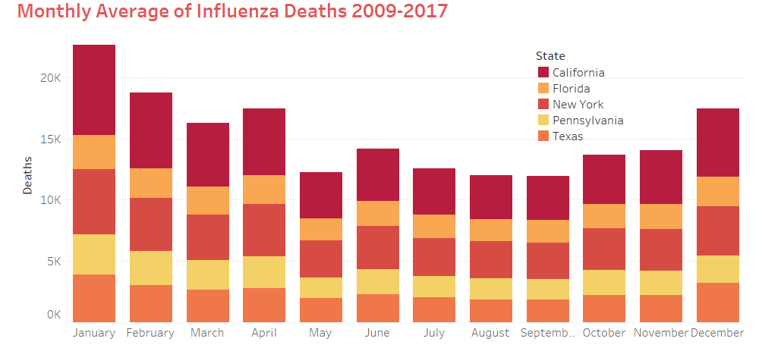
Conclusion
The analysis conducted revealed that Influenza poses a threat to populations over 65 years of age.
The states more populous with this vulnerable age group are California, New York, Texas, Pennsylvania, and Florida.
The months the Influenza Virus is more prominent are December, January, February, March, and April.
The states of California, New York, Texas, Florida, and Pennsylvania have historically high mortality due to Influenza.
It was recommended that medical staff should be sent to these hotspots during the peak months of December through April.
Project link

Slide 9

Rockbuster Stealth Sales analysis
Let’s Explore
Goal: The Rockbuster Stealth Management Board has asked a series of business questions and they expect data-driven answers that they can use for their 2020 company strategy.
Which movies contributed the most/least to revenue gain?
What was the average rental duration for all videos?
Which countries are Rockbuster customers based in?
Where are customers with a high lifetime value based?
Do sales figures vary between geographic regions?

Slide 10


Analysis
Data Sets
Tools
Process
Set up a database environment using the PostgreSQL
Created a data dictionary
Wrote SQL commands in PostgreSQL to answer business questions and organize and sort data
Filtered and ordered data using the WHERE and HAVING clauses
Created a data profile of summary statistics using SQL
Wrote subqueries to answer complex business questions
Rewrote subqueries as Common Table Expressions
Created a presentation of findings
Rockbuster Data Set
Download Data Set
Microsoft Excel

Slide 11
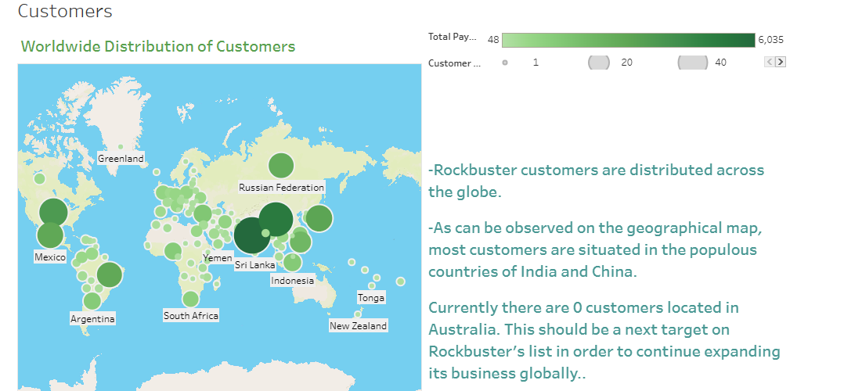
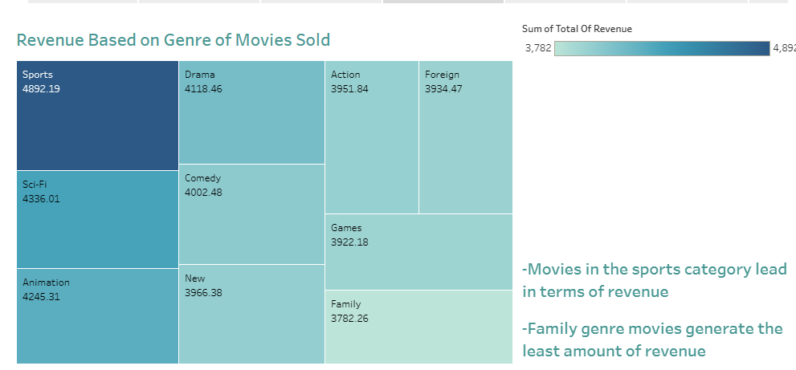
Visualizations of SQL results

Slide 12
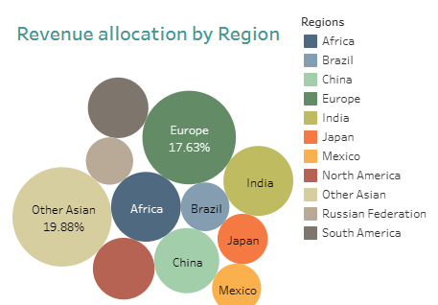
Conclusion
India and China combined contribute to 1/5th of the total revenue generated from all sales.
The Asian market makes up to 40% of all revenue and establishes itself as the principal source of revenue from all Rockbuster sales. Continuation of marketing efforts can still potentially increase the sales numbers in the region.
Also, expansion of marketing campaigns into countries where there are no registered customers, such as Australia, can generate more sources of revenue.
Project Link

Slide 13

Pig E BAnk
LOOKING AHEAD
Goal: To increase customer retention, the sales team wants to identify the leading indicators that a customer will leave the bank.

Slide 14
Analysis
Process
Data Sets
Tools
Researched Software tools for handling big data
Suggested ways of controlling for bias and communicating concerns to stakeholders
Carried out steps in the data mining process, including data cleaning and descriptive statistics
Created a decision tree model to test the outcomes of an analysis
Analyzed the output of a linear regression and Identified the correct predictive model for different scenarios
Created a time series and a simple moving average in Excel
Created a GitHub account and repositories
Pig E Bank Clients Data
Download Data Set
Microsoft Excel

Slide 15
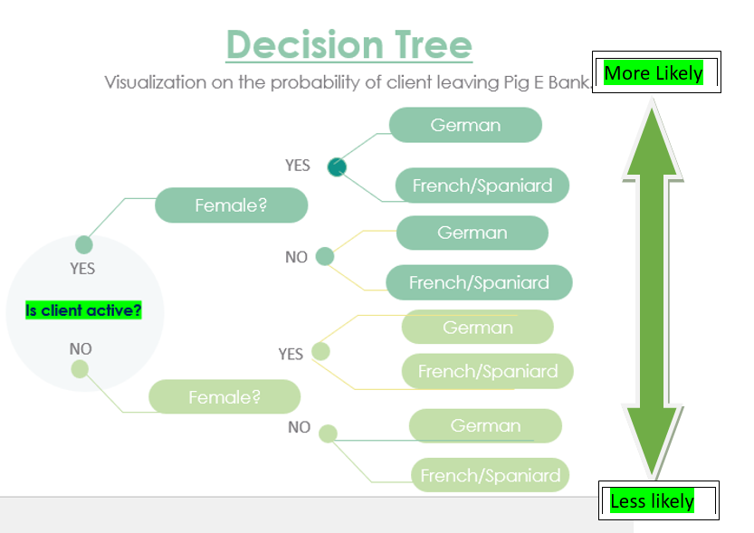
Visualizations

Slide 16
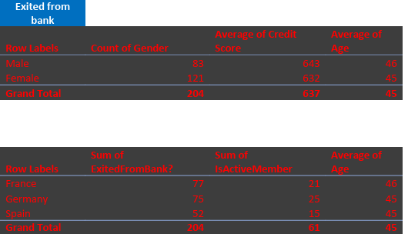
Conclusion
Based on the analysis of the data the determining factors for client loss are:
Inactivity (inactive clients are more likely to leave Pig E Bank)
Gender (Female client loss is disproportionate to males)
Nationality, (75 out of 178 German clients left the bank, highest percentage).
Project Link

Slide 17
Instacart Grocery Basket Analysis
Let’s Take a look
GOAL: To obtain informational knowledge about who the customers are and their purchasing behaviors. To build an effective marketing strategy we need to analyze customers spending habits.
The sales team needs to know what the busiest days of the week and hours of the day are to schedule ads at times when there are fewer orders.
They also want to know whether there are particular times of the day when people spend the most money, as this might inform the type of products they advertise at these times.
Marketing and sales want to use simpler price range groupings to help direct their efforts.
Are there certain types of products that are more popular than others?

Slide 18

Analysis
Process
Data Sets
Tools
Downloaded data and imported into notebook as a panda's data frame
Conducted basic descriptive exploratory tasks
Data Wrangling
Checked Data for Consistency
Analyzed results from merge flag frequencies
Exported merged data as a pickle
Grouped and Aggregated Data
Summarized analysis findings
Created a report describing analysis results, and recommendations for Instacart stakeholders
Instacart Market Data
Download Data Sets
Microsoft Excel

Slide 19
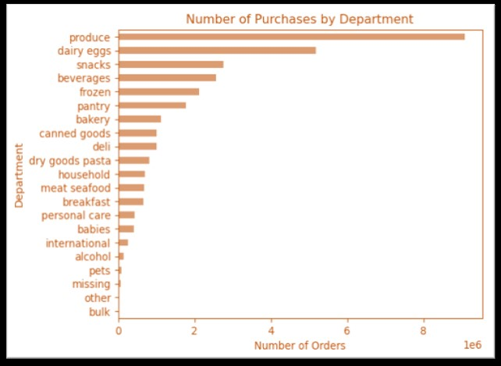
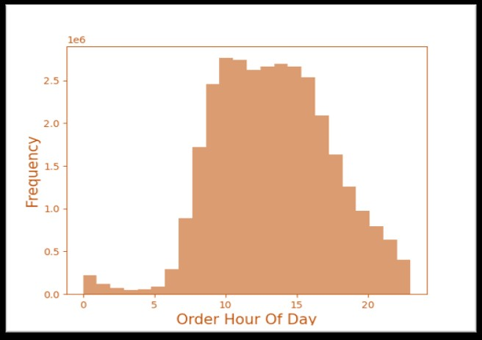
Visualizations
The produce department receives the most orders followed by dairy then snacks.
According to the chart above we can observe that most purchases occur between 9am and 4pm

Slide 20
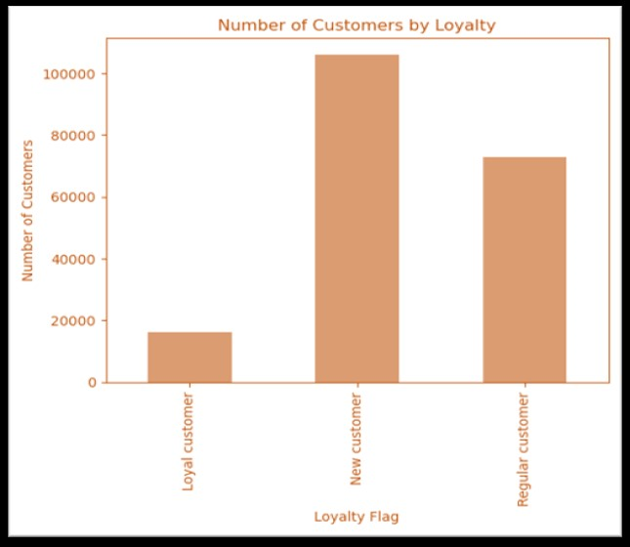
Conclusion
Most orders occur from 9 AM to 4 PM and on weekends. The sales team can schedule ads during off-peak hours to make the most impact when orders are fewer.
Most products are priced between $2 and $15. This highlights a strong preference among customers for affordable and moderately priced items
Focusing promotional efforts on high-demand departments like Produce, Dairy & Eggs, and Snacks products will enable us to create effective marketing campaigns that align with customer needs.
We suggest initiatives to attract new customers, enticing them with appealing offers to make their initial purchases and introduce them to the benefits of loyalty programs.
Project Link

Slide 21
Main factors contributing to happiness
Let’s Dig deeper
GOAL: To determine which factors contribute the most to the happiness of citizens of a country. To assess this, I looked at the World Happiness Report that utilizes data from the Gallup World Poll to generate happiness scores and rankings considering factors such as economic production (GDP_Capita), need for belonging and family/social support (Family), life expectancy (Life_Expectancy), freedom to make decisions in one's life (Freedom), absence of governmental corruption (Gov_Corruption), and societies kindness to one another (Generosity).
Questions to explore on the Analysis:
Which top 5 countries have highest happiness scores?
Which top 5 companies rank the lowest?
Does Freedom correlate with high/low happiness score?
Does GDP_Capita correlate with high/low happiness score?
What is the major contributor to high happiness score?

Slide 22
Analysis
Tools
Process
Data Sets
Microsoft Excel
Sourced the data
Conducted exploratory visual analysis using relevant Python libraries.
Wrangled and cleaned the data. Checked Data for Consistency
Conducted a geospatial analysis by creating a choropleth map using relevant Python libraries
Ran a linear regression on the data and analyzed the model performance statistics.
Performed a cluster analysis
Created Data Dashboards on Tableau based on the results of the analysis.
World Happiness Report
Download Data Sets

Slide 23
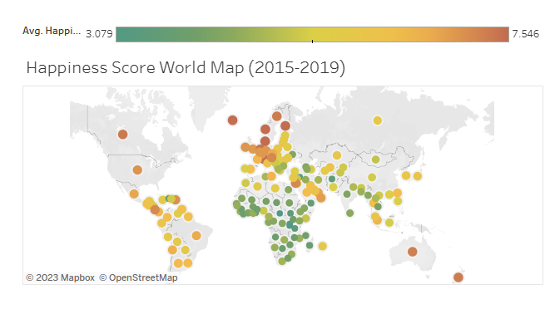
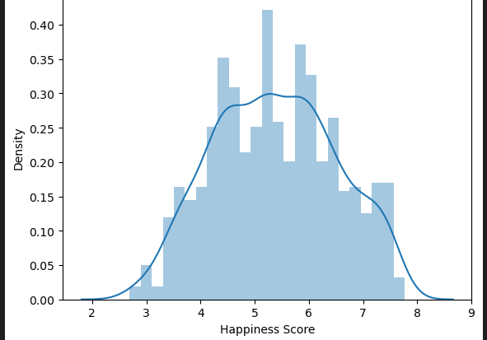
Visualizations
Chart shows the distribution of global happiness scores between 2015 and 2019. The mean happiness score is 5.4.
The world map above visualizes how the happiness scores are distributed globally in terms of high and low.

Slide 24
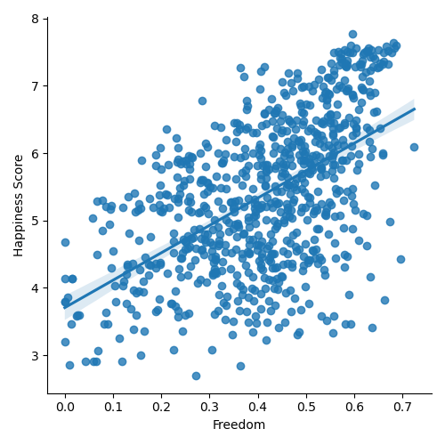
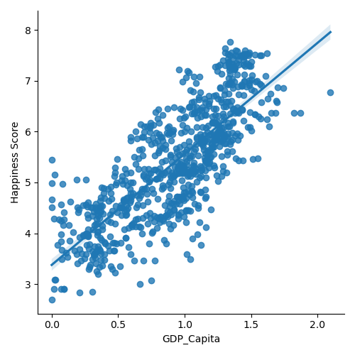
Visualizations
GDP_capita with a calculated R-squared value of .62 is the factor with the most prominent relationship with happiness scores. This tells us that the correlation between the state of the economy and happiness is moderately high
Through regression analysis, we identified an R-squared value of .30, indicating that 30% of the variability in happiness scores can be accounted for by the level of freedom (Left).

Slide 25
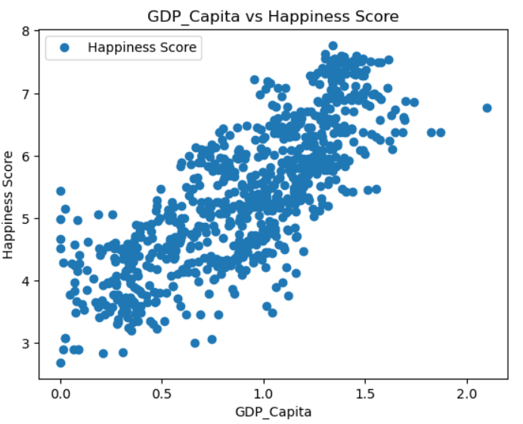
Conclusion
Based on the analysis of the World Happiness Report we can answer our pre analysis questions:
The top 5 ranked countries with the highest happiness scores are: Denmark, Finland, Iceland. Norway, and Switzerland.
The top 5 unhappiest countries are: Burundi, Central African Republic, Rwanda, South Sudan and Syria.
Although the analysis does not disprove the hypothesis that "if a country exhibits a high level of freedom, then it will have a high happiness score", the relationship between the two variables is not as significant as with other factors. The regression analysis revealed a moderately weak correlation between freedom and happiness score.
In summary, our analysis unveiled positive correlations between GDP per capita, and life expectancy with happiness scores. On the other hand, generosity and government corruption had a weak correlation with happiness scores, therefore are not a considerable factor.
Following our results, we determined that the main factor from the report contributing to the happiness level of the population of a country is its GDP per capita or economic production.
Since GDP is the primary driver of happiness scores, to enhance happiness, countries should focus on stimulating economic growth, as changes to life expectancy and other factors are challenging without economic improvement.
Tableau Link
Github Link

Slide 26
Gameco Sales Analysis
Let’s Dig deeper
GOAL: Perform a descriptive analysis of a video game data set to help GameCo understand how their new games might perform in the market, by analyzing global video game popularity and sales worldwide.

Slide 27
Analysis
Data Sets
Tools
Process
VGChartz Data
Download Data Sets
Microsoft Excel
Cleaned the data
Grouped the data
Summarized the data
Conducted descriptive analysis
Created Visualizations
Presented results

Slide 28
Gameco’s Sales Expectations
d
GameCo’s projected sales expectations for the various geographical regions are based on the annual sales history
Looking at data for the past 25 years, GameCo determines that in 2017 the North American market will generate most sales followed by European, and Japanese markets.
What is the reality??

Slide 29
Current state of the video game market
Where are we now?
In 2016, sales in North America have dropped below those of European region.
Europe registered 38% of the global sales surpassing North America (32%) for the first time in history.
Over the past 20 years, we can observe a steady rise in proportion of sales from the European market, while the North American market has seen a sharp decline in sales over the past 5 years

Slide 30

Video game sales in 2016 and A look at the new European market
What has changed?
From 1990-2015, action games had the highest sales average by far, followed by sports, shooter, and racing close behind.
In 2016, shooter games are the top sellers, followed by sports and action which saw the highest drop in sales figures from over 20m per year on average to just over 6m units in 2016.

Slide 31
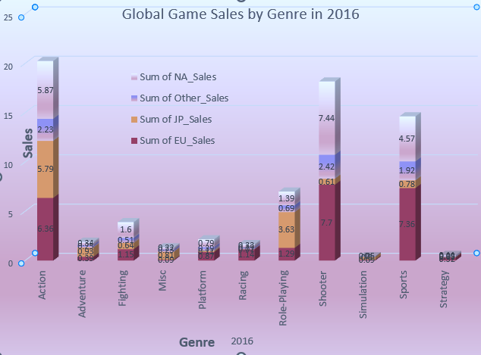
Conclusion
GameCo will have to refocus their business strategy due to the changing market trends. Europe is now the largest market and will require an increase in resources for the region.
Despite a market being dominated by North America historically, in 2016 Europe had the most sales for PC and PS4 platform. North America retained most XOne sales and Japan 3DS sales.
Sales of Action games had the highest drop in 2016 compared to historical data. Sports and Shooter genres are now the top selling genres globally.
Project Link

Slide 32
Chocolate Rating Analysis
Let’s Delve in
Goal: To identify where the best cacao is made, where it derives from, and what makes it a superior product.
Scope: We assessed survey data derived from chocolate tasting events obtained from the Manhattan Chocolate Society. The analysis of this data will be used to aid on the decision-making process for the Brand's strategy on product expansion.
Questions to be answered during the analysis:
1. Which chocolate bars had the best rating?
2. Which manufacturer produces the highest rated chocolate?
3. Where are the top manufacturers located?
3. Is there a correlation between cocoa % and rating?
4. What bean type had the highest average ratings?
6. Where does the highest rated chocolate originate from?

Slide 33
Analysis
Tools
Process
Data Sets
Microsoft Excel
Sourced the data
Conducted exploratory visual analysis using relevant Python libraries.
Wrangled and cleaned the data. Checked Data for Consistency
Conducted a geospatial analysis by creating a choropleth map using relevant Python libraries
Ran a linear regression on the data and analyzed the model performance statistics.
Performed a cluster analysis
Created Data Dashboards on Tableau based on the results of the analysis.
Manhattan Chocolate Society
Download Data Sets

Slide 34
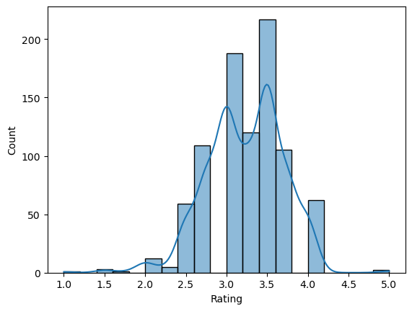
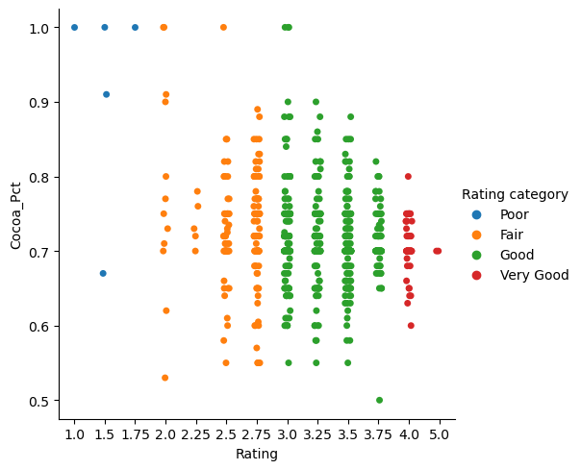
Visualizations
Chart shows the distribution of rating scores between 2006 and 2016. The mean rating score is 3.23.
The scatter plot above displays how the rating scores compare to the cocoa concentrations in the chocolates

Slide 35
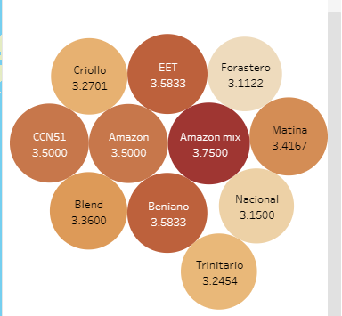
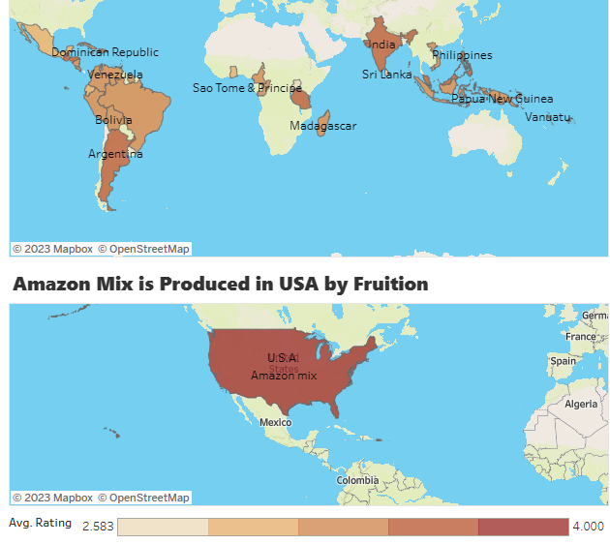
Visualizations
Amazon Mix bean type originating from Costa Rica had the highest average rating given (3.75)
The world map above visualizes how the happiness scores are distributed globally in terms of high and low.

Slide 36
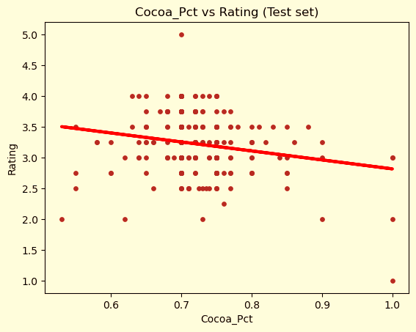
Conclusion
Findings:
There isn't a significant correlation between cocoa percentage and ratings, so our hypothesis that a higher cocoa concentration would result in higher ratings was false.
Top-rated manufacturers include Tobago Estate, Ocelot, and Bar AU Chocolat.
The highest-rated chocolate bar is Toscano Black with a rating of 4.0.
Leading manufacturer locations based on ratings are Singapore, Chile, and Iceland.
Prominent bean origins are the Philippines, Honduras, and Tanzania.
Amazon Mix, Beniano, and EET are among the best-rated bean types.
Recommendations:
Due to data limitations and subjectivity, deriving concrete recommendations is challenging. Incorporating additional numerical metrics like sales and prices across various geographic regions could facilitate a more comprehensive analysis.
Tableau Link
Github Link

Slide 37




THANK YOU
Project links
CONTACT INFORMATION
(25) Brian Avila | LinkedIn
+1 (508) 905 9144
brian.analyst101@gmail.com

